Slide 1
Ceaser Cipher

Slide 2
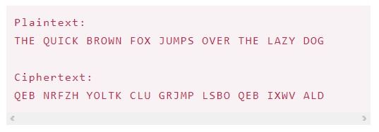
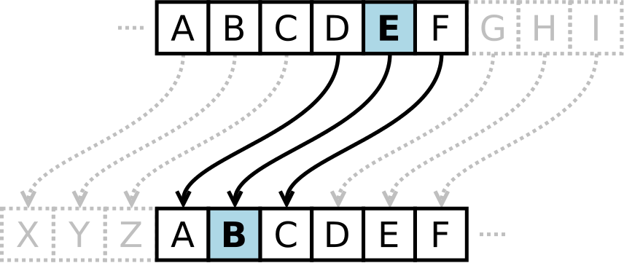
Caesar Cipher encryption of a full message, using a left shift of 3.

Slide 3
65 66 67 68 69 70 71 72 73 74 75 76
A B C D E F G H I J K L
0 1 2 3 4 5 6 7 8 9 10 11
77 78 79 80 81 82 83 84 85 86 87 88
M N O P Q R S T U V W X
12 13 14 15 16 17 18 19 20 21 22 23
89 90
Y Z
24 25
JAVA key/shift=3
Encrypt: MDYD
Decrypt:

